Slide 1
Regularization Techniques

Slide 2
Learning Goals
In this section, we will cover:
- Model complexity vs. error
- Bias and variance of a model
- Sources of model error
- The bias-variance tradeoff

Slide 3
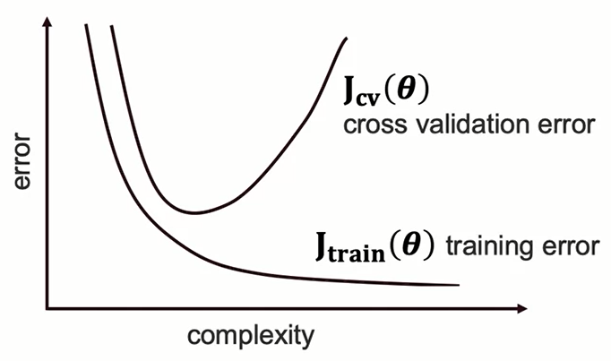
Model Complexity vs. Error

Slide 4
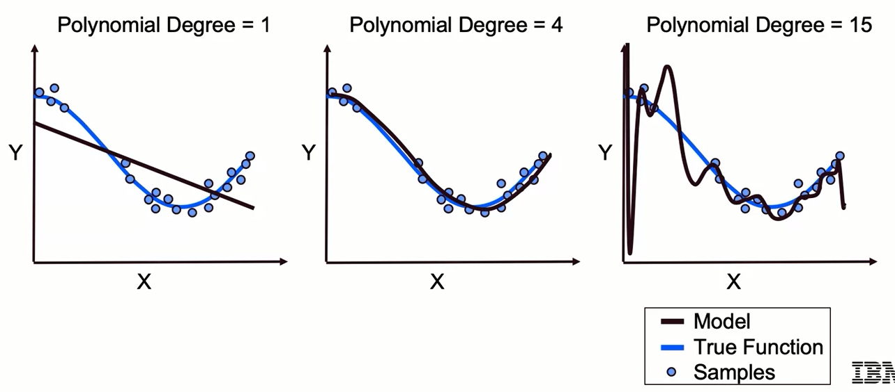
Choosing the Level of complexity

Slide 5
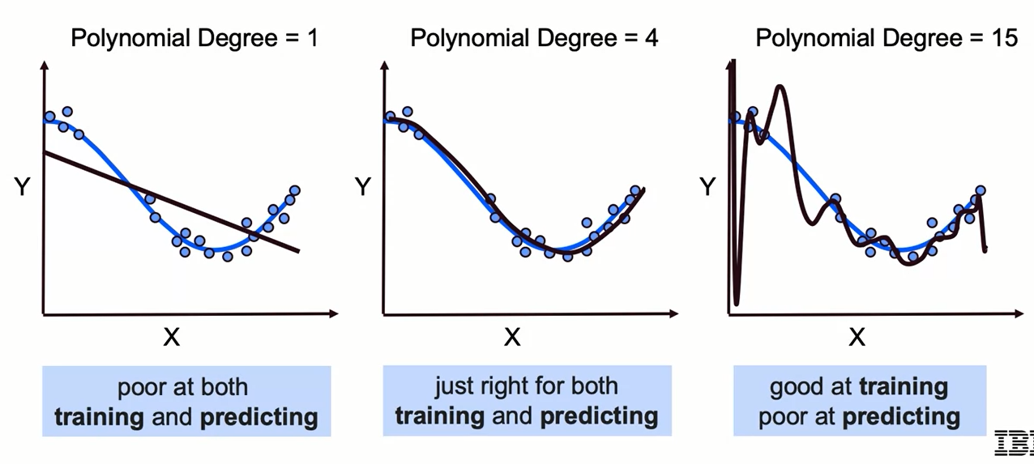
How Well Does the Model Generalize?

Slide 6
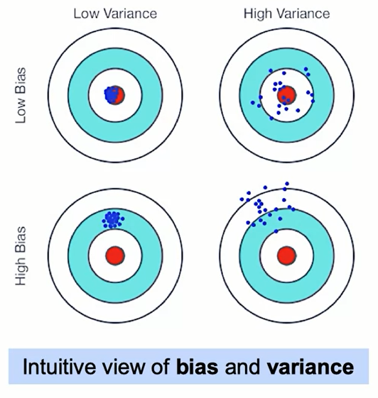
Bias and Variance: Intuition
Bias: is a tendency to miss.
Variance: is tendency to be inconsistent.
Ideally, we want the top left outcome: highly consistent predictions that are close to perfect on average.
Tendency: expectation of out-of-sample behavior over many training set samples.

Slide 7
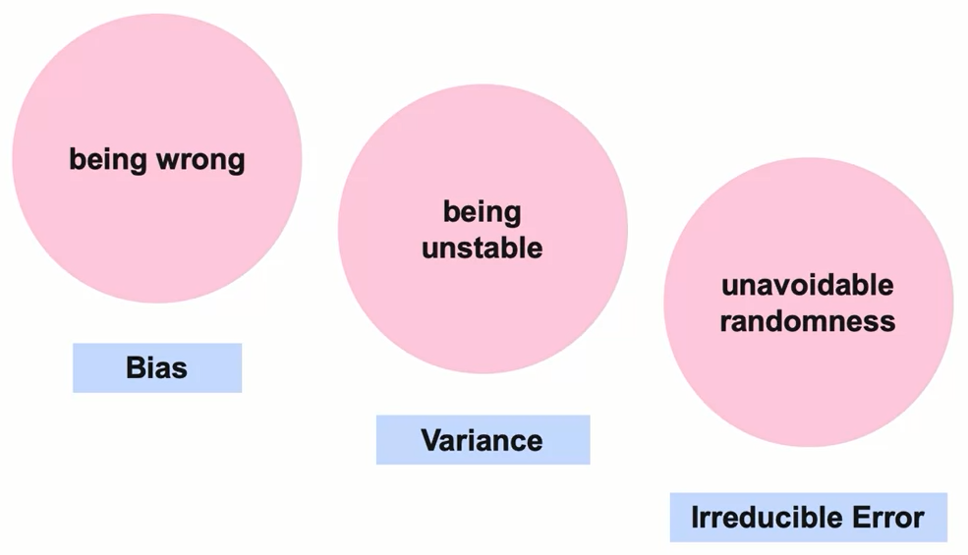
3 Sources of Model Error

Slide 8
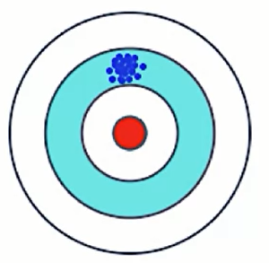
3 Sources of Model Error: Bias
Tendency of predictions to miss true values.
- Worsened by missing information, overly-simplistic assumptions.
- Miss real patterns (underfit).

Slide 9
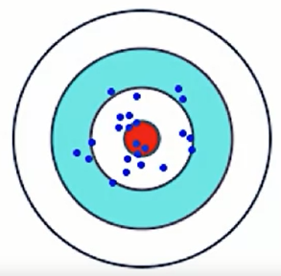
3 Sources of Model Error: Variance
Tendency of predictions to fluctuate.
- Characterized by sensitivity or output to small changes in input data.
- Often due to overly complex or poorly-fit models.

Slide 10
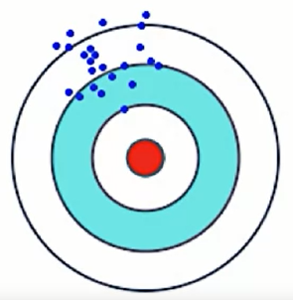
3 Sources of Model Error: Irreducible Error
Tendency to intrinsic uncertainty/randomness.
- Present in even the best possible model.

Slide 11
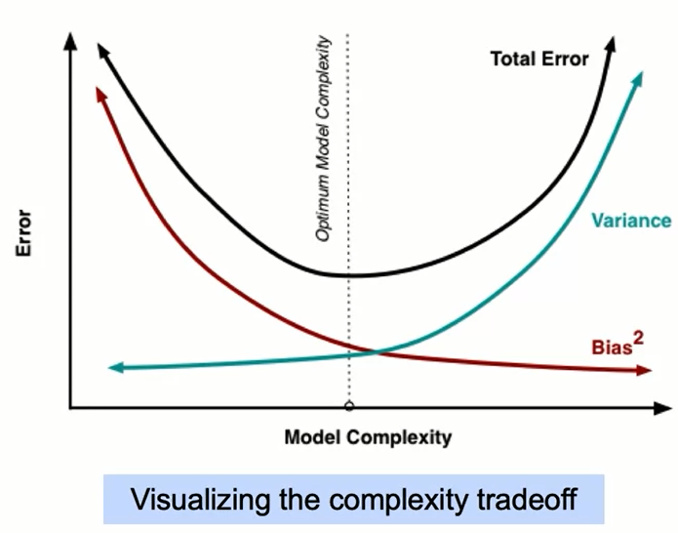
Bias-Variance Tradeoff, Visualized
Summary of bias-variance tradeoff:
- Model adjustments that decrease bias often increase variance, and vice versa.
- The bias-variance tradeoff is analogous to a complexity tradeoff.
- Finding the best model means choosing the right level of complexity.
- Want a model elaborate enough to not underfit, but not so exceedingly elaborate that it overfits.

Slide 12
Bias-Variance Tradeoff: Discussion
- The higher the degree of a polynomial regression, the more complex the model (lower bias, higher variance).
- At lower degrees, we can see visual signs of bias: predictions are too rigid to capture the curve pattern in the data.
- At higher degrees, we see visual signs of variance: predictions fluctuate wildly because of the model's sensitivity.
- The goal is to find the right degree, such that the model has sufficient complexity to describe the data without overfitting.

Slide 13
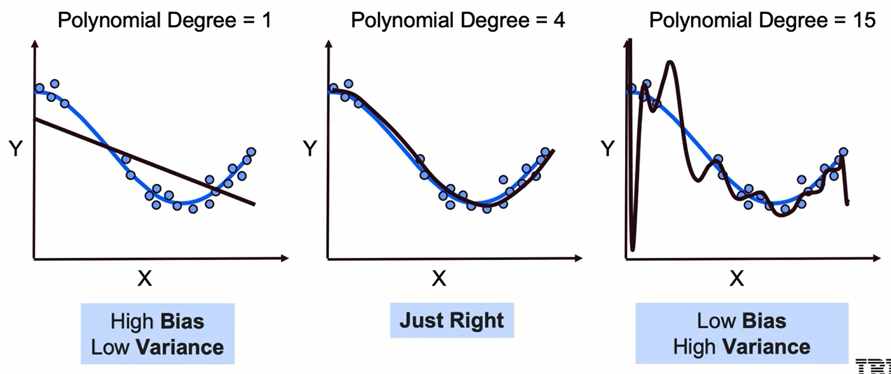
Bias-Variance Tradeoff: Example

Slide 14
Summary
Bias-variance tradeoff decomposes the model's Mean Square Error into two parts: Bias and Variance.
Bias- is a measure of how near the model is to the actual function we are trying to model. If your model has a high bias, the model is underfitting; this means you will do poorly on the training and test data, but the relative results will be similar.
Ways to improve bias include making the model more complex, adding higher order polynomials, obtaining more features or finding more data.
Variance - is the average squared difference of each model you train relative to the average prediction of each model. If your model has high variance, the model will usually overfit the data; this means you will do well on the training data but not on the testing data.

Slide 15
Learning Recap
In this section, we discussed:
- Model complexity vs. error
- Bias and variance of a model
- Sources of model error
- The bias-variance tradeoff

Slide 16
Regularization and Model Selection

Slide 17
Learning Goals
In this section, we will cover:
- Model complexity and error
- Regularization as an approach to over-fitting
- Standard approaches to regularization including Ridge, Lasso, and Elastic Net
- Recursive feature elimination

Slide 18

Model Complexity vs. Error

Slide 19
Tuning the Model
Can we tune with more granularity than choosing polynomial degrees?
Yes, by using regularization.

Slide 20
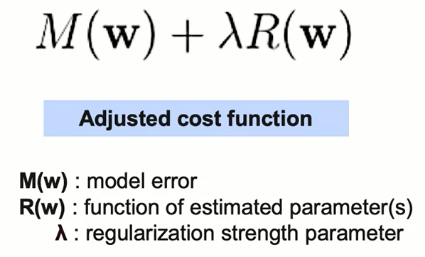
What does Regularization Accomplish?
Regularization adds an (adjustable) regularization strength parameter directly into the cost function.
This 𝛌 (lambda) adds a penalty proportional to the size of the estimated model parameter, or a function of the parameter.
Increasing the cost function controls the amount of the penalty.

Slide 21
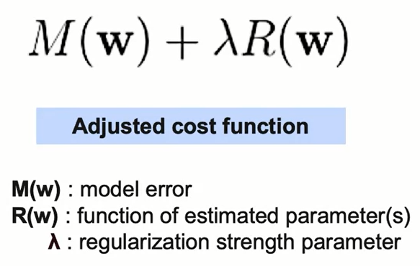
What does Regularization Accomplish?
The regularization strength parameter 𝛌 (lambda) allows us to manage the complexity tradeoff:
- more regularization introduces a simpler model or more bias.
- less regularization makes the model more complex and increases variance.
If our model is overfit (variance too high), regularization can improve the generalization error and reduce variance.

Slide 22
Regularization and Feature Selection
Regularization performs feature selection by shrinking the contribution of features.
For L1-regularization, this is accomplished by driving some coefficients to zero.
Feature selection can also be performed by removing features.

Slide 23
Why is Feature Selection Important?
Reducing the number of features can prevent overfitting.
For some models, fewer features can improve fitting time and/or results.
Identifying most critical features can improve model interpretability.

Slide 24
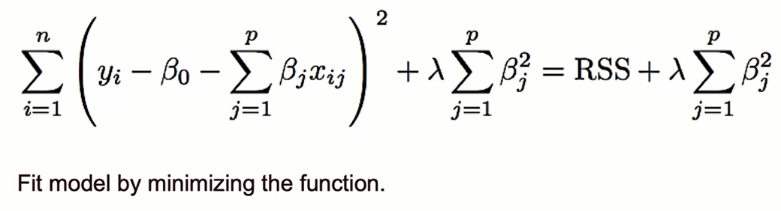
Reg Cost Function: Ridge Regression

Slide 25
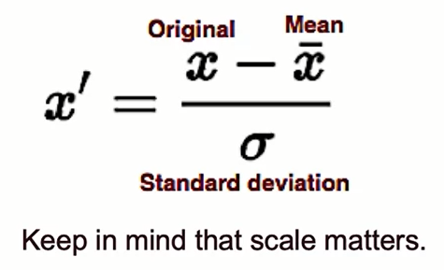
Reg Cost Function: Ridge Regression

Slide 26
Reg Cost Function: Ridge Regression
Ridge Regression:
the complexity penalty 𝛌 is applied proportionally to squared coefficient values.
- The penalty term has the effect of "shrinking" coefficients toward O.
- This imposes bias on the model, but also reduces variance.
- We can select the best regularization strength lambda via cross-validation.
- It's best practice to scale features (i.e. using Standard Scaler)
so penalties aren't impacted by variable scale.

Slide 27
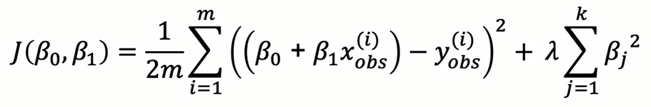
Ridge Regression (L2)
Penalty shrinks magnitude of all coefficients
Larger coefficients strongly penalized because of the squaring

Slide 28
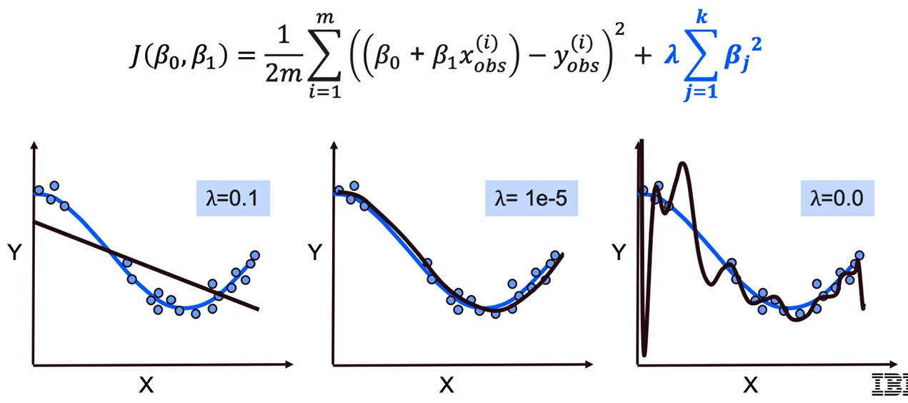
Preventing Under- and Over-Fitting

Slide 29
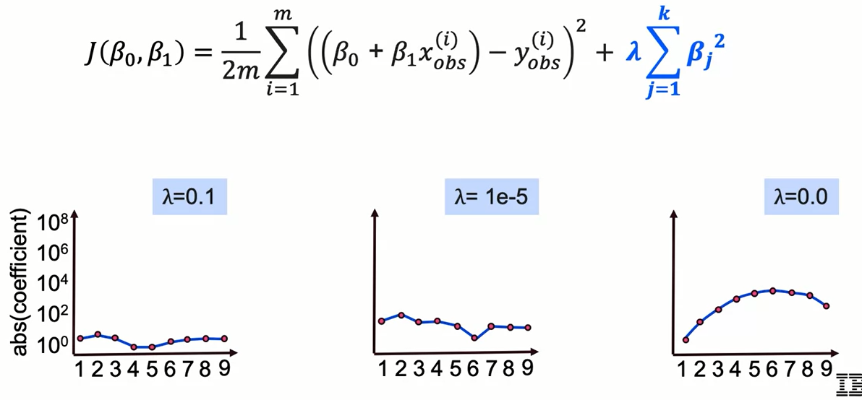
Preventing Under- and Over-Fitting

Slide 30
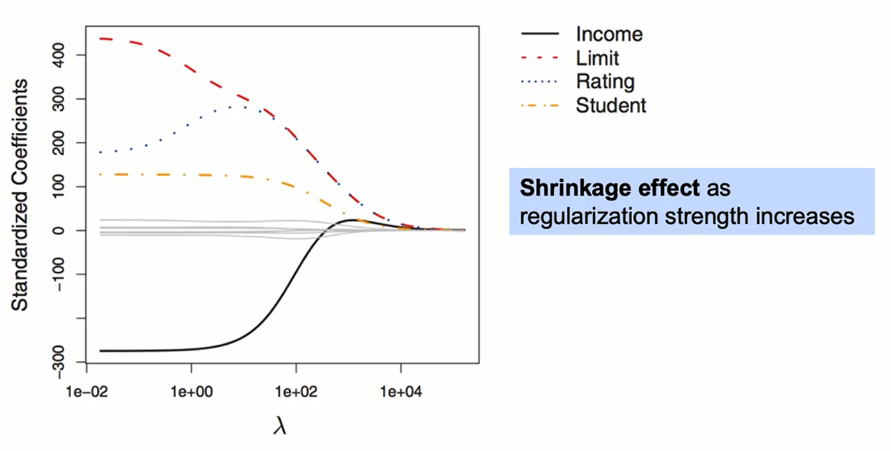
Ridge Regression in Action

Slide 31
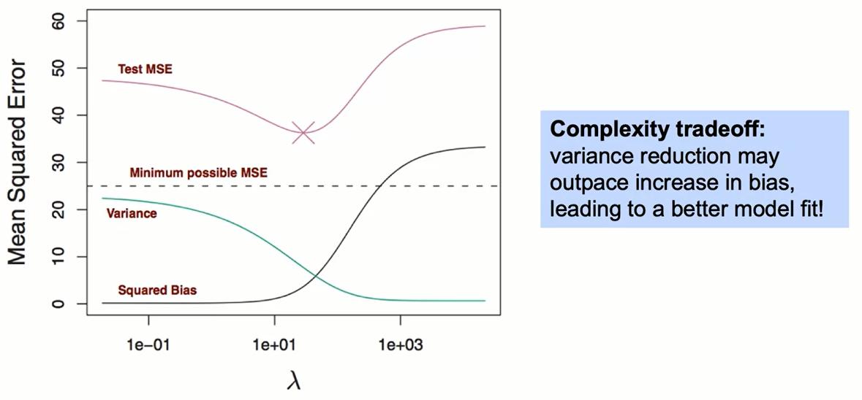
Ridge Regression in Action

Slide 32
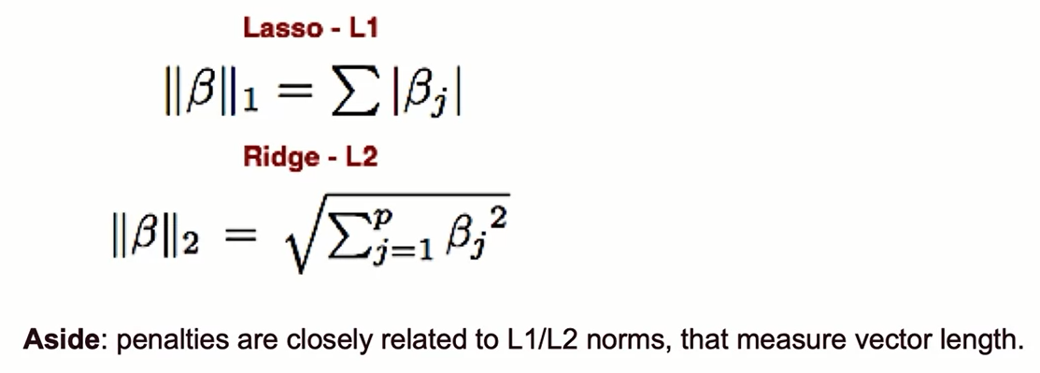
Alternative: LASSO Regression

Slide 33
Alternative: LASSO Regression
In LASSO regression: the complexity penalty 𝛌 (lambda) is proportional to the absolute value of coefficients.
- LASSO: Least Absolute Shrinkage and Selection Operator.
- Similar effect to Ridge in terms of complexity tradeoff:
increasing lambda raises bias but lowers variance.
- LASSO is more likely than Ridge to perform feature selection, in that for a fixed A, LASSO is more likely to result in coefficients being set to zero.

Slide 34
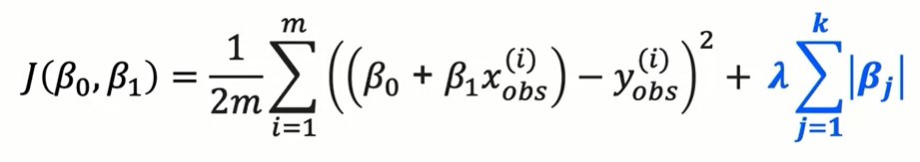
Lasso Regression (L1)
Penalty selectively shrinks some coefficients.
Can be used for feature selection.
Slower to converge than Ridge regression.

Slide 35

Preventing Under- and Over-Fitting

Slide 36
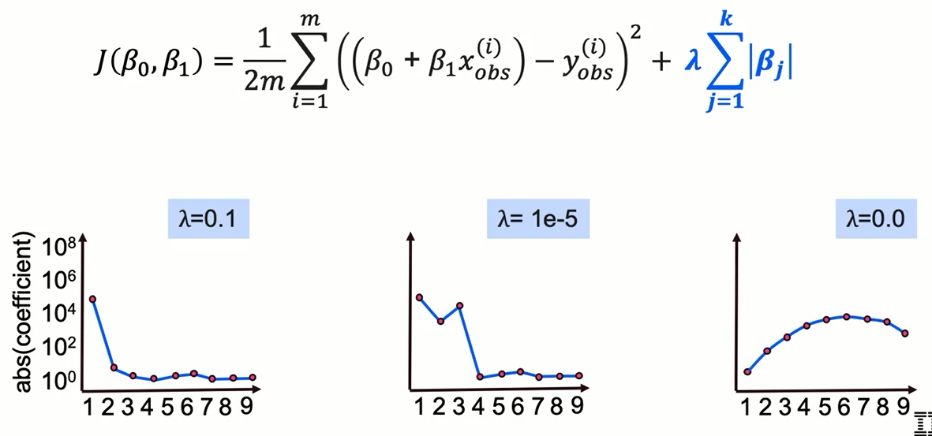
Preventing Under- and Over-Fitting

Slide 37
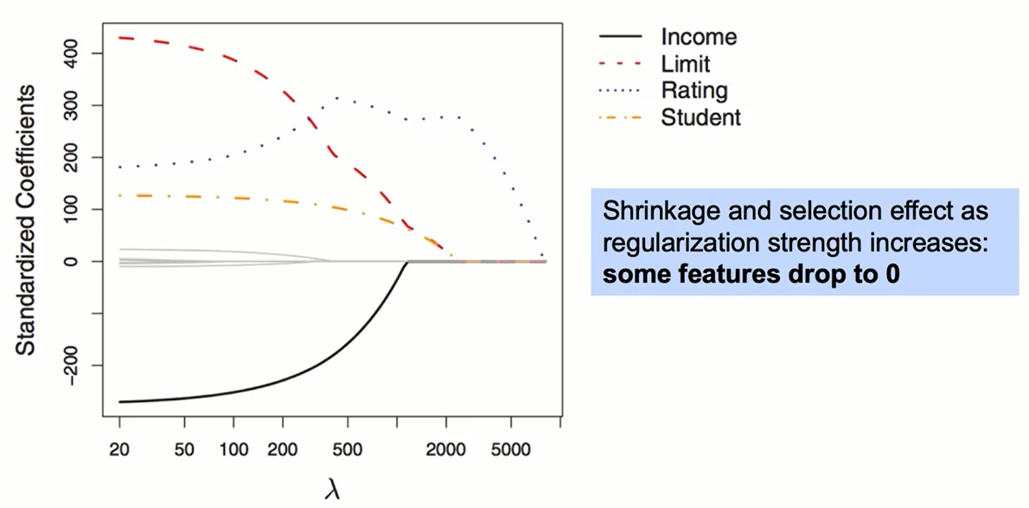
LASSO Regression in Action

Slide 38
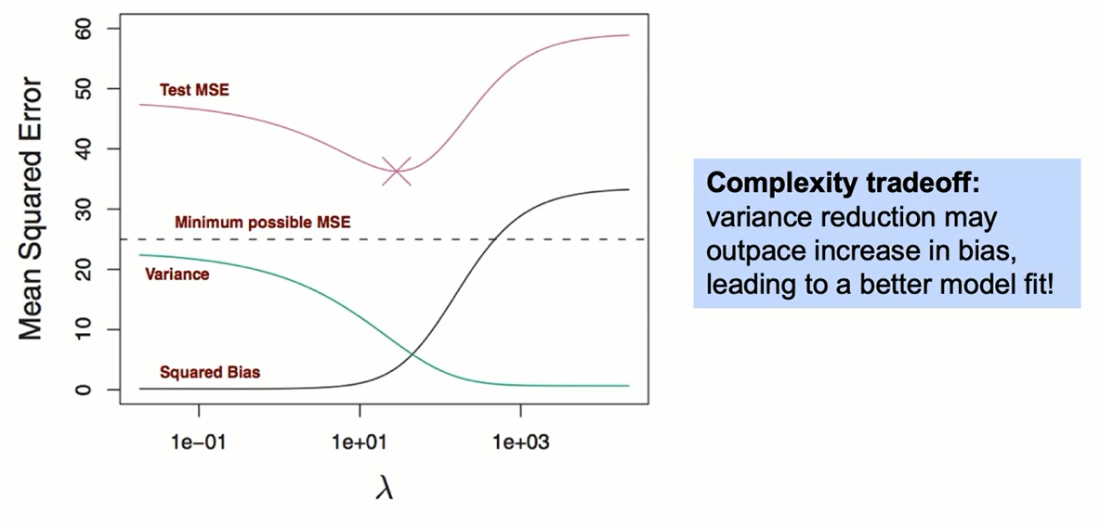
LASSO Regression in Action

Slide 39
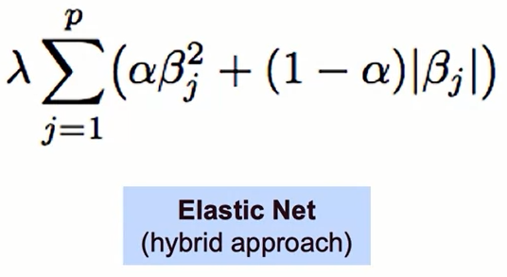
Between Ridge and LASSO: Elastic Net
Validation gives us an empirical method for selecting between different models.
LASSO's feature selection property yields an interpretability bonus, but may underperform if the target truly depends on many of the features.
Elastic Net, an alternative hybrid approach, introduces a new parameter 𝛂 (alpha) that determines a weighted average of L1 and L2 penalties.

Slide 40
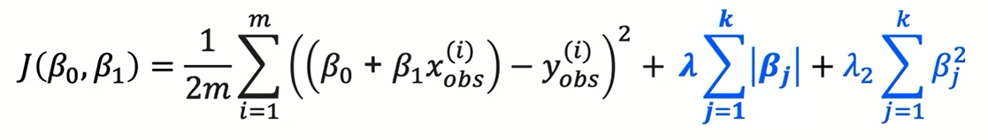
Elastic Net Regularization
Elastic Net combines penalties from both Ridge and LASSO regression.
It requires tuning of an additional parameter that determines emphasis of L1 vs. L2 regularization penalties.

Slide 41
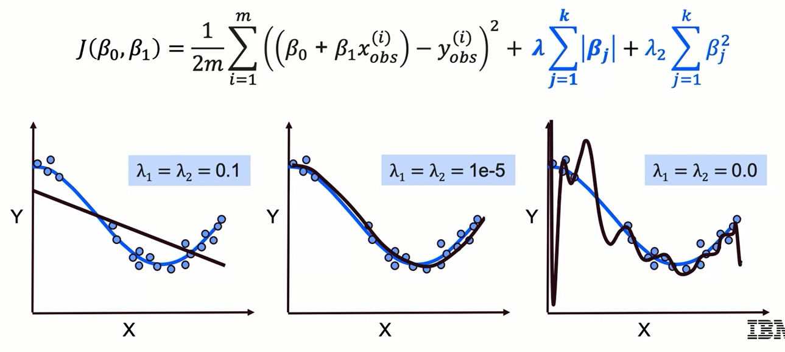
Elastic Net Regularization

Slide 42
Recursive Feature Elimination
Recursive Feature Elimination (RFE) is an approach that combines:
- A model or estimation approach
- A desired number of features
RFE then repeatedly applies the model, measures feature importance, and recursively removes less important features.

Slide 43
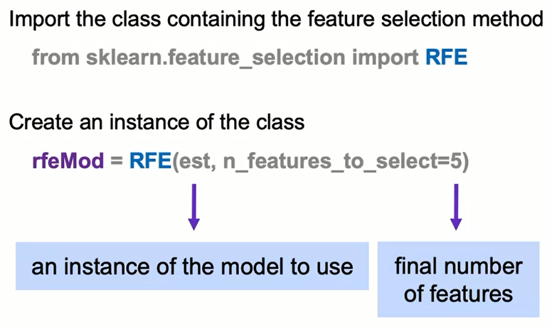
Recursive Feature Elimination: The Syntax

Slide 44
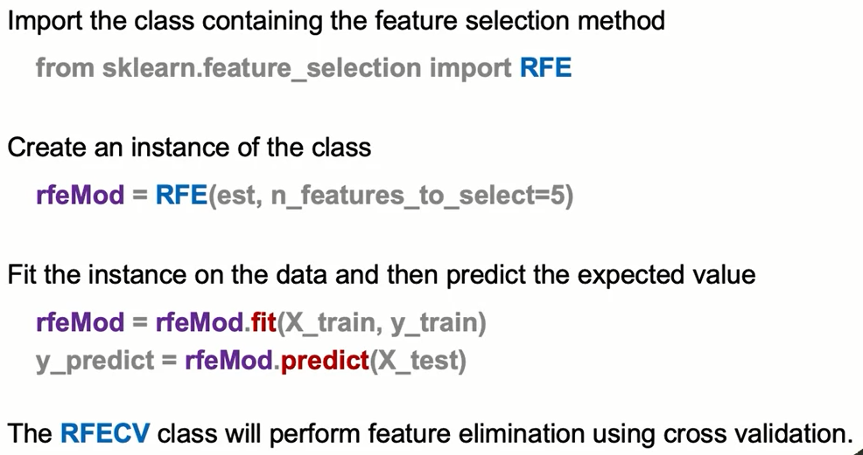
Recursive Feature Elimination: The Syntax

Slide 45
Summary
You can improve variance by making the model less complex, i.e., lowering the order of the polynomial, obtaining more data or using Regularization. There are 3 regularization techniques discussed in this Module: Ridge, LASSO, and Elastic Net.
Ridge (L2 Regularization)
penalizes the size magnitude of the regression coefficients by adding a squad term
enforces the coefficients to be lower, but not 0
minimizes irrelevant features and does not remove them
faster to train
LASSO (L1 Regularization)
penalizes the absolute value of the coefficients
sets irrelevant features to 0
finds features you don't need
Elastic Net (L1+L2 Regularization)
penalizes the size magnitude of the regression and absolute value of the coefficients
sets irrelevant features to 0 and enforces the coefficients to be lower

Slide 46
Learning Recap
In this section, we discussed:
- Model complexity and error
- Regularization as an approach to over-fitting
- Standard approaches to regularization including Ridge, Lasso, and Elastic Net
- Recursive feature elimination

